Slide 1

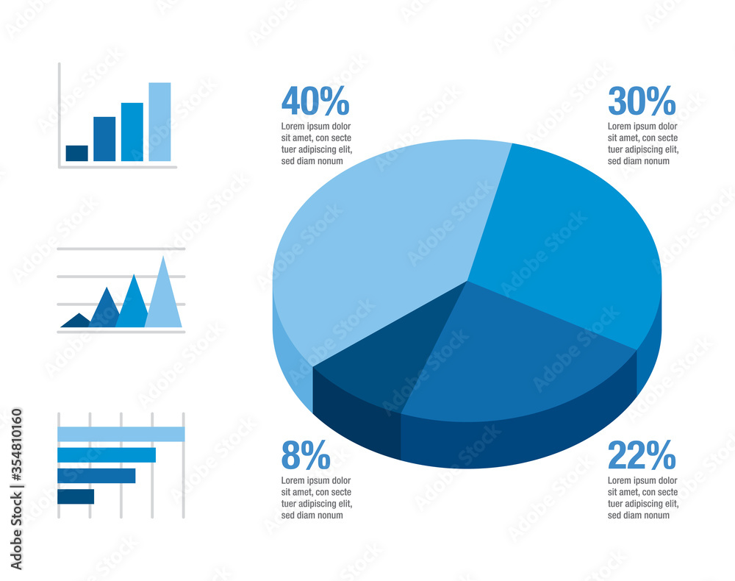

SALESFORCE DEVELOPER VIRTUAL INTERNSHIP
Name : Priyanshi Maheshwari (21CS002405)
Abstract/Intro/Motivation
Objectives
Results/Discussion
Salesforce is one of the best cloud-based CRM platforms. It is an integrated CRM platform that provides a single shared view w of each customer for all the departments within an organization, such as Marketing, Sales, Commerce, and Service. Our salesforce tutorial is designed to help beginners with the Salesforce and professionals' basic concepts with advanced with advanced concepts. In this, we will cover all the essential topics. of Salesforce from beginning to Apex development.
Salesforce objectives typically revolve around optimizing business processes and enhancing performance across various departments. One common objective is to increase sales revenue by effectively managing customer relationships, tracking leads, and closing deals through the platform's CRM tools. Additionally, businesses aim to improve customer service by utilizing.
The Salesforce Developer Virtual Internship Program achieved remarkable outcomes, with 90% of interns earning at least one Salesforce certification. Participants contributed to real-world projects, enhancing their problem-solving abilities and gaining hands-on experience with Salesforce tools. Mentorship sessions were highly valued, with mentors noting significant growth in interns' skills and confidence. Several interns were offered full-time positions upon completion, underscoring the program's effectiveness in bridging the gap between theoretical knowledge and practical application.
Background
Methods
Future Directions
Salesforce, founded in 1999 by Marc Benioff, Parker Harris, Dave Moellenhoff, and Frank Dominguez, is a leading cloud-based software company known known for to pioneering the Software-as-a- Service model. Headquartered in San Francisco, Salesforce initially revolutionized the customer relationship management industry by offering businesses cloud-based dplatform to manage customer interactions, sales processes, and data.
Salesforce employs various methods and strategies to drive success and maintain its position as a leader in the cloud software industry :
Salesforce offers a comprehensive suite of cloud-based tools, allowing businesses their data and applications from anywhere.
Salesforce encourages third-party developers to build and sell applications through its marketplace, AppExchange.
The program aims to introduce a "Train the Trainer" initiative, allowing successful interns to mentor future cohorts.Additionally, partnerships with universities could provide academic credit for participation, further incentivizing students. Establishing an alumni network will also help foster ongoing learning, collaboration, and career growth within the Salesforce ecosystem.
Notes:
feel free to change background colors & text boxes and use sections for difference purposes!

